Slide 1
Color Compatibility From Large Datasets
Peter O’Donovan
University of Toronto
Aseem Agarwala
Adobe Systems, Inc.
Aaron Hertzmann
University of Toronto

Slide 2
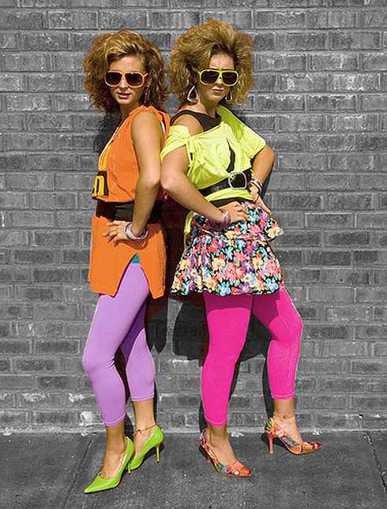

Choosing colors is hard for many people
Notes:
Choosing colors can hard for many people, whether it’s choosing an outfit for a ‘hot date’…

Slide 3
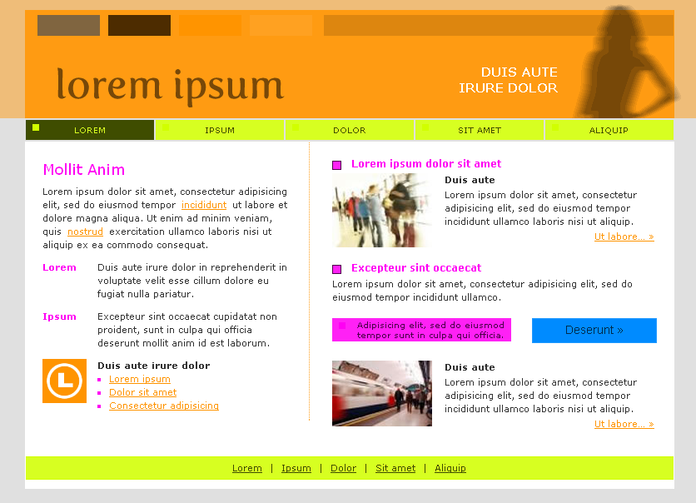
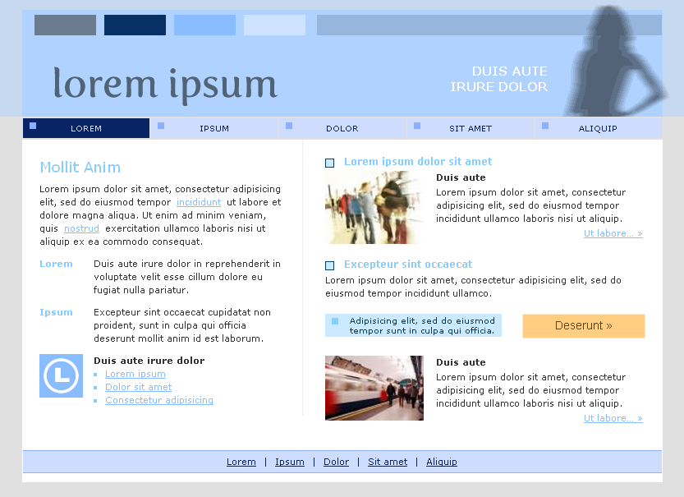
Choosing colors is hard for many people
Notes:
Or creating a palette for a website, color choices can make the difference between an poor distracting design, and a clear readable one.

Slide 4

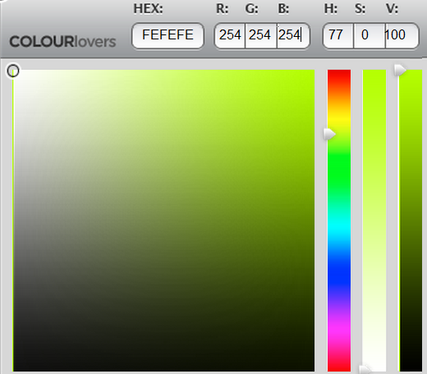

?
Notes:
For many of us, particularly non-designers, choosing colors can be overwhelming and intimidating however. Choosing a color (for example for this cat’s body) often involves manually exploring the color space, usually with simple tools like color sliders or squares, which is both time-consuming and fairly subjective.

Slide 5
How do designers choose colors?
Notes:
So how do designers choose colors? Often this involves searching for examples of successful color combinations which can be used as a starting point for a design.

Slide 6
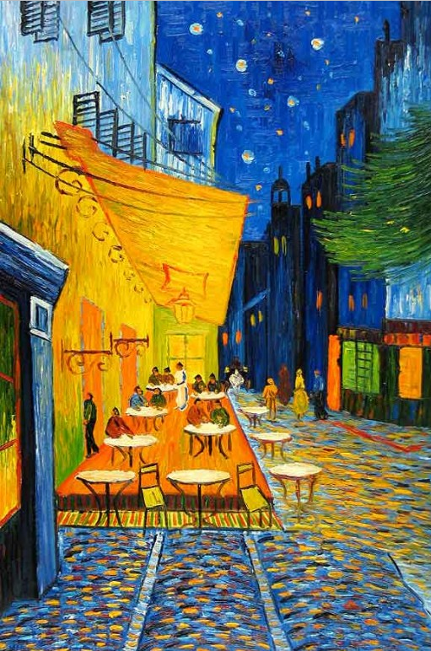
How do designers choose colors?
Picasso
Notes:
Such examples can be found anywhere from art

Slide 7

How do designers choose colors?
You the Designer
Notes:
To blogs; the article shown here offers ’44 cool flyer designs for inspiration’.
But artists also look at more abstract color combinations.

Slide 8
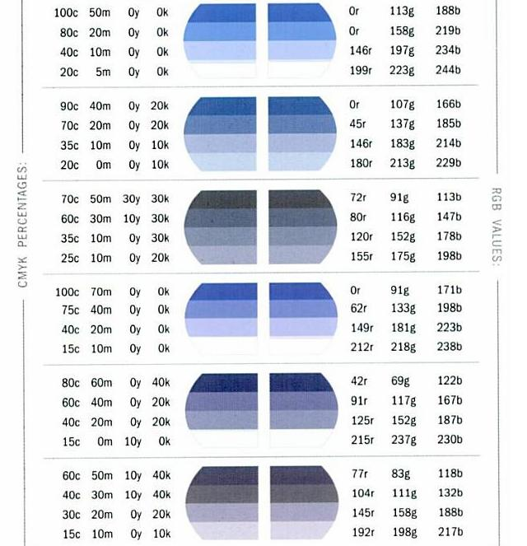
How do designers choose colors?
Krause [2002]
Notes:
Such as those found in color palette books. Examining colors without context (like these palettes) can be useful for artists, again by providing successful examples.

Slide 9
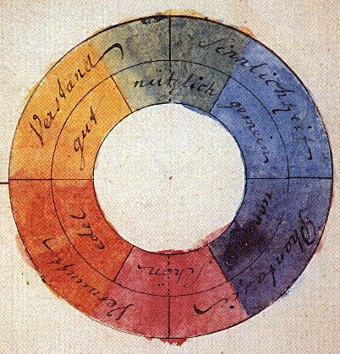
Goethe [1810]
Complementary Color Theory: colors opposite on the color wheel are compatible
Notes:
Philosophers and scientists have also long been interested in understanding color compatibility and have proposed numerous theories.
Two centuries ago Goethe described complementary color theory: that colors opposite on the color wheel are compatible. So blue is compatible with orange, red is compatible with green, etc.

Slide 10
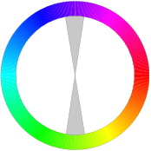
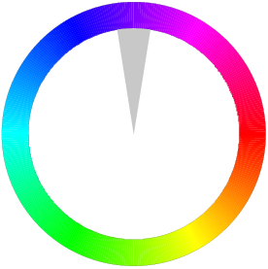

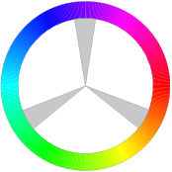
Hue Templates: relative orientations producing compatible colors
Complementary
Monochromatic
Analogous
Triad
Notes:
Over the centuries, this idea became generalized to hue templates: relative orientations about the hue wheel which produce compatible colors. So the complementary template has hues 180 degrees apart, monochromatic has only a single hue, analogous as a spread of similar hues, etc. Hue templates like this are the most popular form of color compatibility, appearing in many art and design books, websites,

Slide 11
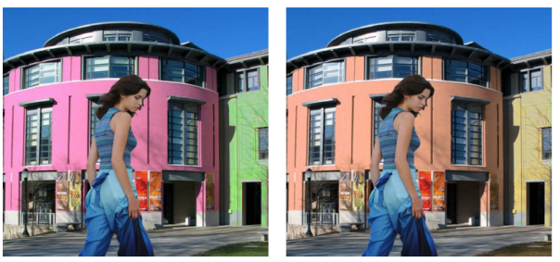

Color Harmonization
Cohen-Or et al. 2006
Photo and Video Quality Evaluation:
Focusing on the Subject
Luo and Tang 2008
Color Harmonization for Videos
Sawant and Mitra 2008
Aesthetic Visual Quality Assessment of Paintings
Li and Chen 2009
Notes:
As well as several graphics and vision papers.
However, there has been fairly little evaluation of different hue templates, and it’s an open question as to how well they work in practice.

Slide 12
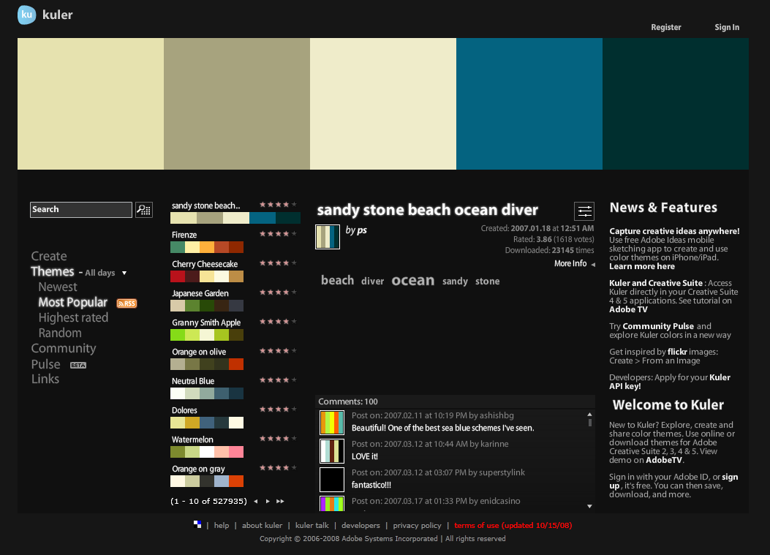
Notes:
Several websites allow users to create and share color palettes or themes. A color theme is an ordered set of 1-5 colors.

Slide 13
Adobe Kuler
527,935 themes
Ratings: 1-5 stars
Notes:
On site is Adobe Kuler, which has over a half a million themes

Slide 14
Adobe Kuler
527,935 themes
Ratings: 1-5 stars
Notes:
Users can tag themes with keywords.

Slide 15
Adobe Kuler
527,935 themes
Ratings: 1-5 stars
Notes:
Write comments

Slide 16
Adobe Kuler
527,935 themes
Ratings: 1-5 stars
Notes:
And rate themes between 1 to 5 stars.

Slide 17
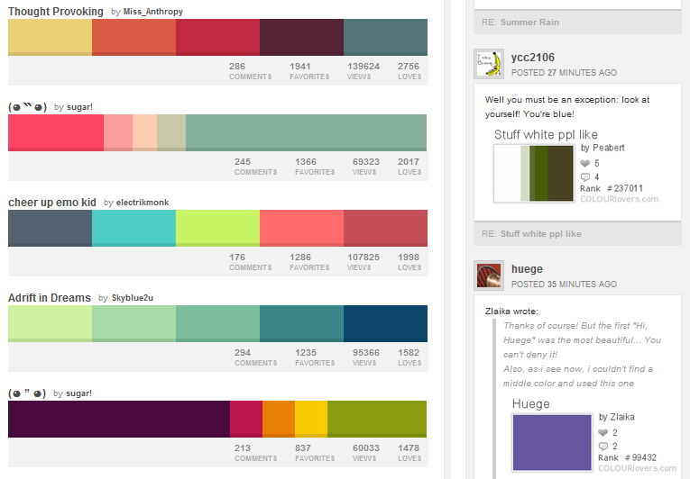
COLOURLovers
1,672,657 themes
Views and “Likes”
Notes:
Another popular site is COLOURLovers, which has over a million and a half user-created themes which users can ‘like’ instead of directly rating them.

Slide 18
COLOURLovers
1,672,657 themes
Views and “Likes”
Notes:
And also includes social networking features for comments and discussion.
The vast amount of data on these sites presents a fascinating new opportunity. For the first time, we can now examine color compatibility in practice, and also model it with large-scale data-driven approaches.

Slide 19
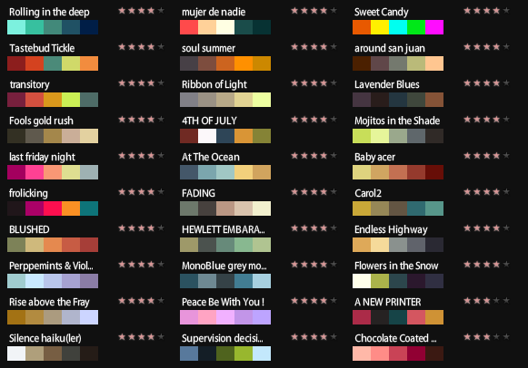
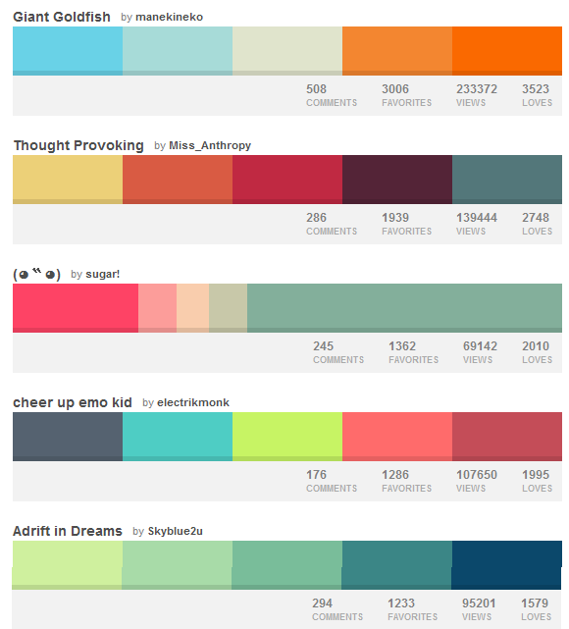
Kuler Dataset
COLOURLovers Dataset
104,426 themes
Ratings: 1-5 stars
383,938 themes
# Views and “Likes”
Notes:
For this project we collected two initial datasets: 100,000 rated themes from Kuler and 400,000 themes from COLOURLovers. However, these sites do have numerous biases. For example, users are more likely to be designers or highly aware of color. There are also selection biases since popular themes tend to be viewed and rated more often, the so-called ‘rich get richer’ effect.

Slide 20
Hue Template Analysis
Notes:
Since hue templates are the most popular theory for color compatibility, we analyze them in greater detail. First, we’ll explain the basic properties of this model, and then test them against the data.

Slide 21
Hue Templates: relative orientations producing compatible colors
Notes:
As we mentioned earlier, a hue template is defined as a fixed rotation along the color wheel. The complementary template are colors 180 degrees apart, for example, green and purple….

Slide 22

Hue Templates: relative orientations producing compatible colors
Templates are rotationally invariant
Notes:
…or teal and orange. This is because template theory assumes rotationally invariance, so any rotation is equally compatible.

Slide 23
Hue Templates: relative orientations producing compatible colors
Complementary
Monochromatic
Analogous
Triad
Different templates equally compatible
Notes:
Past color theorists have also defined sets of hue templates which are assumed to be all equally compatible.

Slide 24
Template Conclusions
Templates do not model color preferences
Themes near a template do not score better than those farther away
Not all templates are equally popular
Simple templates preferred (see paper)
Notes:
In this work, we examined hue templates from several angles and found them generally to be a poor model.
First, there are strong color preferences so not all rotations of templates are equally compatible.
Second, themes near templates do not score better than those farther away.
Third, not all templates are equally popular. In the paper we examine this in more detail, but one observation is that the most popular themes tend to be fairly simple, with roughly one or two distinct hues. This suggests that how simple or complex a theme is might help predict the rating.

Slide 25
Hue Entropy: entropy of hues along the hue wheel
Notes:
To examine this, we define a simplicity measure based on hue entropy, which is roughly speaking the spread of hues along the hue wheel.

Slide 26

Hue Entropy: entropy of hues along the hue wheel
Low Entropy
Few Distinct Colors
Notes:
Low entropy corresponds to few distinct colors

Slide 27

Hue Entropy: entropy of hues along the hue wheel
Low Entropy
High Entropy
Few Distinct Colors
Many Distinct Colors
Notes:
Low entropy corresponds to few distinct colors, and high entropy corresponds to many distinct colors

Slide 28
Main Analysis Results
1. Overall preference for warmer hues and cyans
Notes:
To summarize our main analysis results, we’ve shown an overall preference for warmer hues and cyans.

Slide 29
Main Analysis Results
1. Overall preference for warmer hues and cyans
2. Strong preferences for certain adjacent colors
Notes:
A strong preference for certain adjacent colors,

Slide 30
Main Analysis Results
1. Overall preference for warmer hues and cyans
2. Strong preferences for certain adjacent colors
3. Hue templates a poor model for compatibility
Notes:
That hue templates are a poor model for color compatibility,

Slide 31
Main Analysis Results
1. Overall preference for warmer hues and cyans
2. Strong preferences for certain adjacent colors
3. Hue templates a poor model for compatibility
4. People prefer simpler themes (but not too simple)
Notes:
And that people generally prefer simpler themes, but not too simple.

